Slide 1



GETTING YOUR COLLEAGUES STARTED WITH R
Dr Lyndon Walker
Veritate Data Science
https://www.linkedin.com/in/lyndon-walker/
@drlyndonwalker

Slide 2
About me
Types of teaching scenarios – who, why, how
Useful resources
Tips for teaching R individually and in groups
Questions and discussion
AGENDA

Slide 3
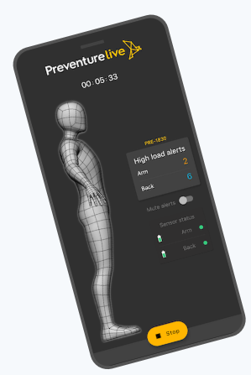
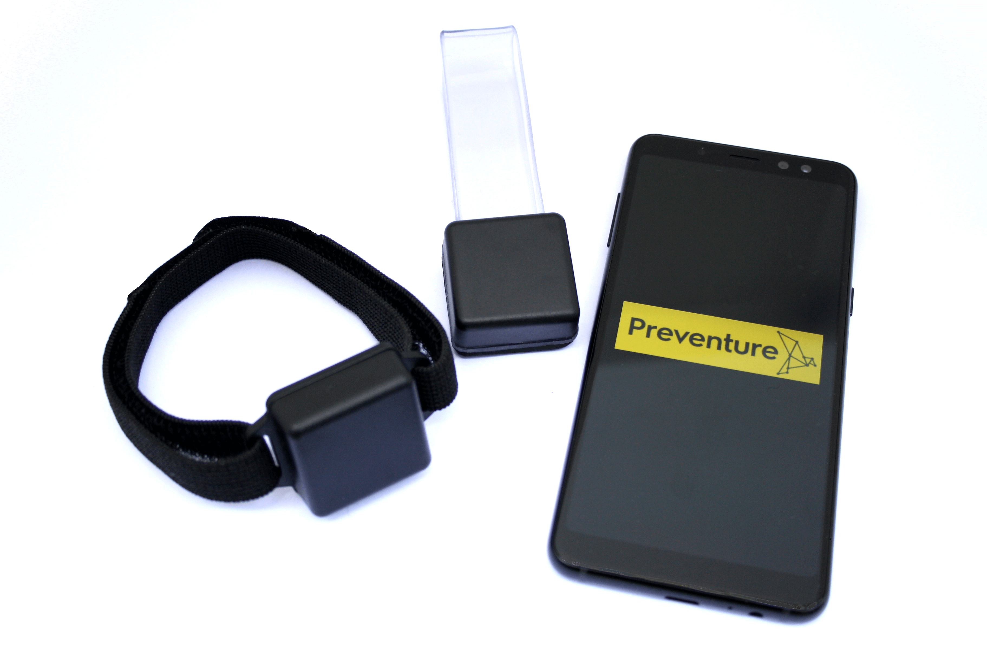
Used R for 22 years
Former university lecturer
Now
Provider of data science/statistical consulting & training
Statistician at psychometrics test company
Investor/advisor in wearable tech startup
ABOUT ME

Slide 4
“One” to “one”
Questions to ask
Why learn R?
What does firm usage look like?
Who is responsible?
What’s most important to cover?
Many to “one”
COMMON
TEACHING SCENARIOS
“One” to many

Slide 5
Programming experience?
Writing code is much easier but can be disoriented by comparing it to other languages
Other software experience?
TYPES OF LEARNERS
Statistics knowledge?
Can be overlooked, especially in some “data science” and analyst roles

Slide 6
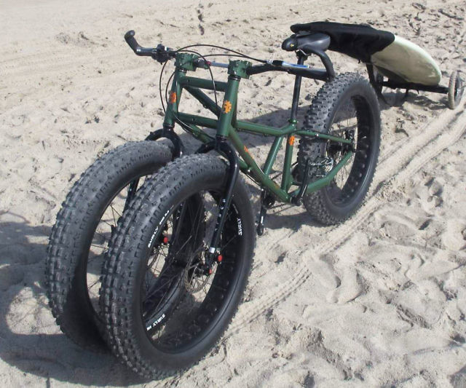
Recommending Resources
Don’t reinvent the wheel but make sure you have the right tyres for the job.

Slide 7

Free Resources
Paid Resources
MOOCs (e.g. Coursera/edx)
YouTube
Free sites (e.g. R Cookbook, Quick-R)
Meetups
Books/ebooks
Ask a question sites (stackexchange, quora, etc)
DIY resources for your company
Professional development workshops (onsite and off-site)
Subscription, cheap, or freemium paid sites: CodeAcademy, Udemy, LinkedIn Learning, Skillshare etc
University courses
Books/ebooks

Slide 8
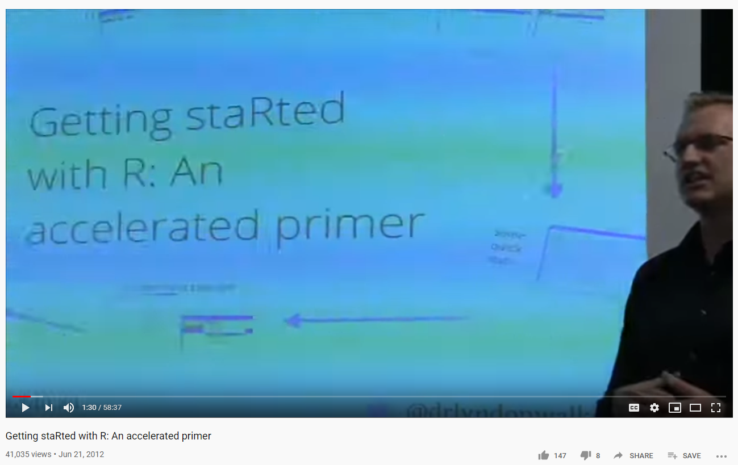
CHECK THE AGE OF YOUR RESOURCES

Slide 9
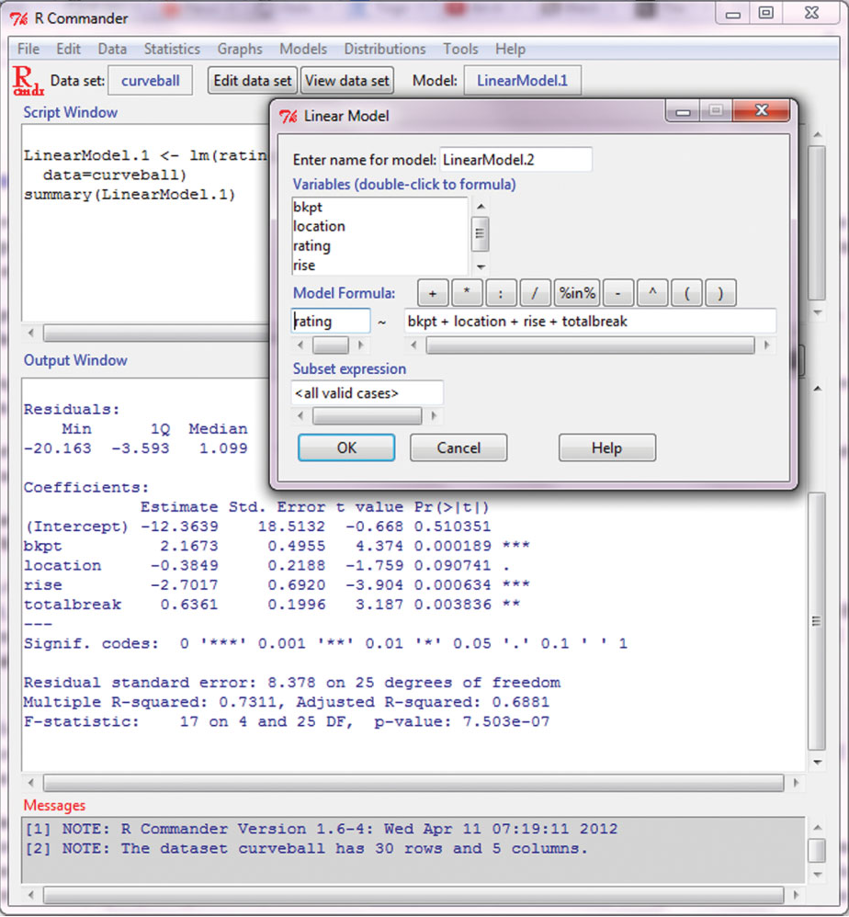
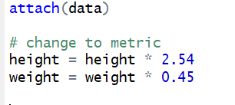
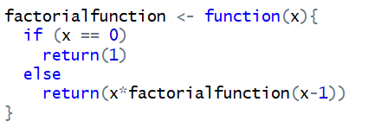
CHECK QUALITY OF RESOURCES
R Commander makes it point and click like SPSS

Slide 10
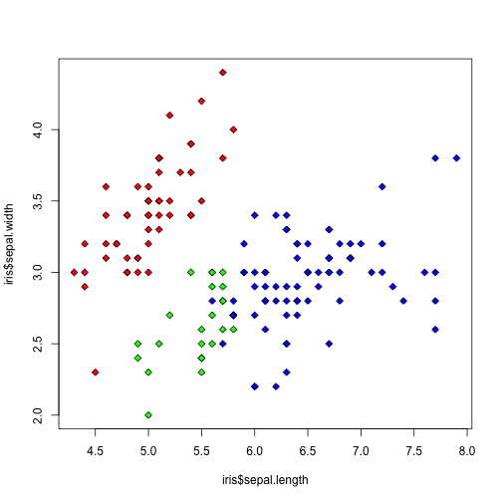
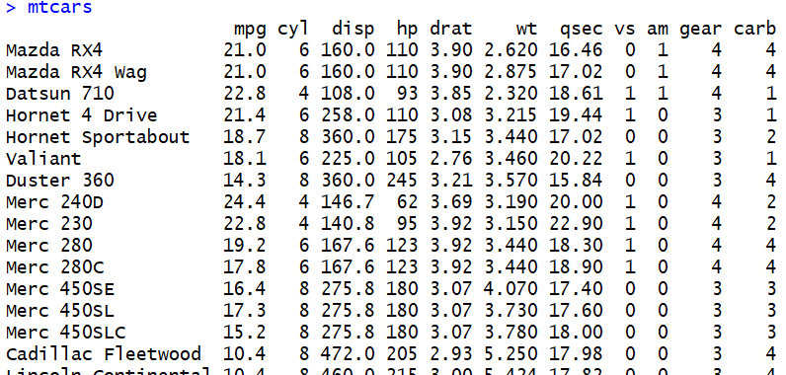
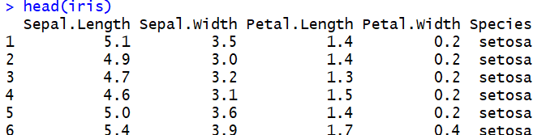
USE INTERESTING AND RELEVANT DATA

Slide 11
Keep your own biases in mind
“The doorstep to the temple of wisdom is a knowledge of our own ignorance”
BENJAMIN FRANKLIN

Slide 12
Screen Capture Video
Narrating/explaining as you work
Live or pre-recorded
Camtasia, Zoom, Windows Game Bar (Win+G), OBS
Create a repository/hub for material
Lots of options – Sharepoint, Dropbox, wiki, lms, notebook (e.g. Jupyter), github
Focus on workflow, team styles & usage
Be proactive with support
MAKE YOUR OWN RESOURCES

Slide 13
Case sensitivity
Using a command line (especially for creating/storing vs displaying on screen)
“It didn’t save my code”
Blindly following templated code without trying to understand (or it isn’t explained)
Functions vs variables (understanding structure)
Steps in instructions/lessons that are assumed
help() isn’t always that helpful
Paths
Piping?
*Non-standard evaluation
*The idiosyncrasies (http://r4stats.com/articles/why-r-is-hard-to-learn/)
SOME COMMON DIFFICULTIES

Slide 14
Community of Practice Model
Create a community who meet regularly and help teach each other as peer support/mentors
Can vary in skill level
Have leader/facilitator(s) to keep things organized (often better not the R expert)
Set learning goals, hold peer presentations
https://elearningindustry.com/top-10-tips-create-corporate-learning-community-of-practice
Mastermind Group
Business oriented
More often external with networking agenda
COMMUNITY OF PRACTICE & MASTERMINDS
(peer mentors)

Slide 15

Questions & Discussion
Teaching is the best way to learn
Thank you for listening

